Slide 1

presents
HTML and CSS

Slide 2
HTML Basics
Tags
Attributes
Links and page anchors
Forms and input
HTML 5 semantic layout elements
Block-level vs inline
The box model
Comments
Best practices
How to incorporate CSS
Adding JavaScript

Slide 3
What is HTML?

Slide 4
HTML is a markup language.
HTML uses tags to markup elements.
Notes:
Tags are hidden keywords within a web page that define how your web browser must format and display the content

Slide 5
<p> Let's learn some stuff! </p>
The basic tag structure
Notes:
Tags are hidden keywords within a web page that define how your web browser must format and display the content

Slide 6
Common tags
html body head title
h1-h6 p i strong b center
table tr th td ul ol li
br a span img script style link

Slide 7
Open your text editor and create a new file.
Save the file as index.html
Save it to the Desktop. Double-click the file to open in Chrome. Let’s add the following code to it….

Slide 8
Basic page structure.
<!DOCTYPE html>
<html>
<head>
<title></title>
</head>
<body>
</body>
</html>
Notes:
The <!DOCTYPE html> declaration defines this document to be HTML5
The <html> element is the root element of an HTML page
The <head> element contains meta information about the document
The <title> element specifies a title for the document
The <body> element contains the visible page content

Slide 9
Don’t forget, the <head> is just that information we want to tell the browser.

Slide 10
Add the title and then save the document!
<head>
<title>Demo</title>
</head>
Where do you think this will display?

Slide 11
Meta tags continued…
What if I wanted to add some underlying information about my site?
Metadata is data (information) about data.
Metadata can be used by browsers (how to display content or reload page), search engines (keywords), or other web services data (information) about data.

Slide 12
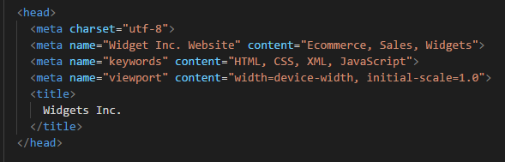
Meta Tags: Nested in the <head> element.
No need to type this.

Slide 13
Common tags
html body head title
h1-h6 p i u b center
table tr th td ul ol li
br a span img script style link

Slide 14
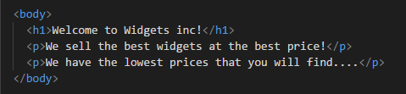
Adding text to our page.
Save your index.html
Preview in Chrome.

Slide 15
Quick styling with HTML tags
How can we transform and call out specific areas of our HTML?
We can use built in tags to transform text, such as <i></i> and <u></u>
Let’s center our text, add an underline and an italic to our paragraph……

Slide 16
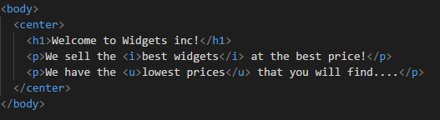
Styling text with tags.
Save your index.html
Preview in Chrome.

Slide 17
Common tags
html body head title
h1-h6 p i u b center
table tr th td ul ol li
br a span img script style link

Slide 18
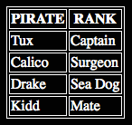
Let’s say we want to make a table
What do we need?

Slide 19
Table Syntax
<table>
<tr> <th> PIRATE </th> <th> RANK </th> </tr>
<tr> <td> Tux </td> <td> Captain </td> </tr>
<tr> <td> Calico </td> <td> Surgeon </td> </tr>
<tr> <td> Drake </td> <td> Sea Dog </td> </tr>
<tr> <td> Kidd </td> <td> Mate </td> </tr>
</table>
You don’t need to add this to your code.

Slide 20
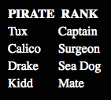
Where did the borders go?
For that we would need styles.

Slide 21
Tables are great for displaying information. But we can also use lists. Let’s take a look at an HTML Ordered List and an Unordered List.

Slide 22
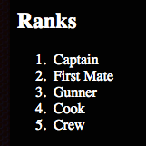
There are two kinds of lists
Ordered Lists

Slide 23
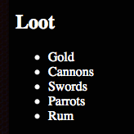
There are two kinds of lists
Unordered Lists

Slide 24
Ordered List
<h2>Ranks</h2>
<ol>
<li>Captain</li>
<li>First Mate</li>
<li>Gunner</li>
<li>Cook</li>
<li>Crew</li>
</ol>

Slide 25
Unordered List
<h2>Loot</h2>
<ul>
<li>Gold</li>
<li>Cannons</li>
<li>Swords</li>
<li>Parrots</li>
<li>Rum</li>
</ul>

Slide 26
Common tags
html body head title
h1-h6 p i strong b center
table tr th td ul ol li
br a span img script style link

Slide 27
You can set properties of elements, by giving them attributes.
Notes:
Attributes provide additional information about an element
Attributes modify or add meaning to an HTML element.

Slide 28

<a href=“https://www.google.com”> Google </a>
Basic attribute usage on a hyperlink.
Tag
Closing Tag
Attribute
Value
What the user sees.
|
|
The entire element
Notes:
anchor tag marks the beginning and the end of a hypertext link

Slide 29
<a href=“#widget-list”>View our Widgets!</a>
Hyperlinks as page anchors.
What the user sees.
ID of the element you want to jump to.

Slide 30
Other commonly used attributes
href target src alt
title width height
Notes:
target attribute specifies where to open the linked document
src attribute is the image source (image.jpg) and alt is additional info about an image

Slide 31
An image is an excellent example of the need for attributes
<img src=“parrot.png”>

Slide 32
An image with alt and title attributes
<img src=“parrot.png” alt=“Polly wants a cracker.” title=“Polly wants a cracker.” >

Slide 33
How do we add an extra line between elements?

Slide 34
How do we add an extra line between elements?
<br>
<br> does not need a closing tag or any attributes.

Slide 35
Sometimes we need to group elements together. How do we do that?

Slide 36
Sometimes we need to group elements together. How do we do that?
<span> </span>
Notes:
difference between span and div is that a span element is in-line and usually used for a small chunk of HTML inside a line (such as inside a paragraph) whereas a div (division) element is block-line (which is basically equivalent to having a line-break before and after it) and used to group larger chunks of code

Slide 37
Sometimes we need to group elements together. How do we do that?
We can also use:
<div> </div>
Notes:
difference between span and div is that a span element is in-line and usually used for a small chunk of HTML inside a line (such as inside a paragraph) whereas a div (division) element is block-line (which is basically equivalent to having a line-break before and after it) and used to group larger chunks of code
The <div> tag defines a division or a section in an HTML document.
The <div> tag is used to group block-elements to format them with CSS.

Slide 38
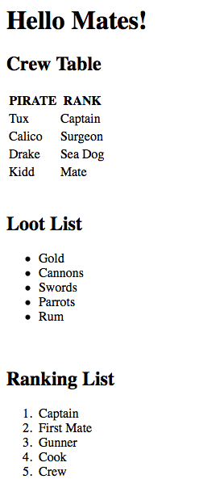
Quick test your skills
Code out the display on the right as best as you can with the tags you know.

Slide 39
HTML Basics
Tags
Attributes
Links and page anchors
Forms and input
HTML 5 semantic layout elements
Block-level vs inline
The box model
Comments
Best practices
How to incorporate CSS
Adding JavaScript

Slide 40
Getting user input
Let’s take a look at how forms are structured!

Slide 41
The major tags of HTML forms
form & input

Slide 42
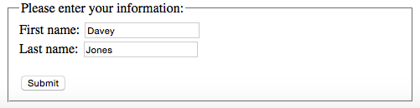
Let’s make a form

Slide 43
Setting up our form
<form>
<fieldset>
<legend>Please enter your information:</legend>
First name: <input type="text" name="firstName" value="Davey”><br>
Last name: <input type="text" name="lastName" value="Jones”><br>
<br>
<input type="submit" value="Submit">
</fieldset>
</form>
Add this to your code.
Notes:
Clicking the submit button will send us to the page that is the action
Fieldset is used to group related elements in a form

Slide 44
Quick Exercise
When coding we learn best by doing!
Let’s build a new web page from scratch that has a form.
Research “HTML form ACTION” and set the action as
mailto:info@devcodecamp.com
For inputs types you can use TEXT, but you need to have 2 more options. You will need to research RADIO BUTTONS and CHECK BOXES for examples on how to incorporate them. Also include a SUBMIT and RESET button.
http://www.w3schools.com/html/html_forms.asp

Slide 45
HTML Basics
Tags
Attributes
Links and page anchors
Forms and input
HTML 5 semantic layout elements
Block-level vs inline
The box model
Comments
Best practices
How to incorporate CSS

Slide 46
HTML 5 and Semantic Elements
Many web sites contain HTML code like: <div id="nav"> <div class="header"> <div id="footer"> to indicate navigation, header, and footer.
HTML5 offers new semantic elements to define different parts of a web page

Slide 47
Semantic elements
are what they sound like
header
nav
section
<header> - heading with intro
<nav> - navigation
<section> - elements grouping
<article> - self contained element
<footer> - page footer
<aside> - related sidebar
aside
article
footer

Slide 48
Let’s talk spacing and layouts
Block-level, inline, and the box model

Slide 49
There are two types of elements:
block and inline

Slide 50
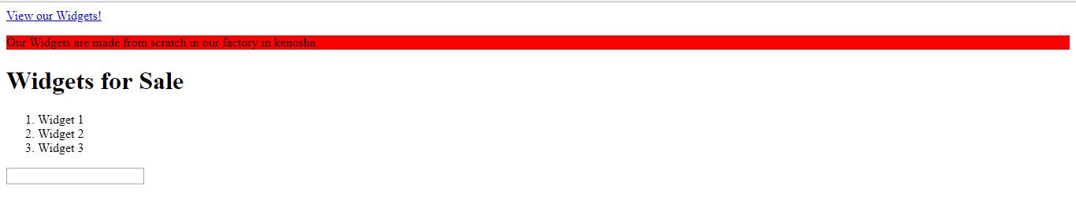
Block-level elements
Begin a new line
Take up the full width of whatever element (or page) they are in
Examples:
ul, pre, h1, h3, p, blockquote, div, form
Here <p> has a background color of red to illustrate that.

Slide 51
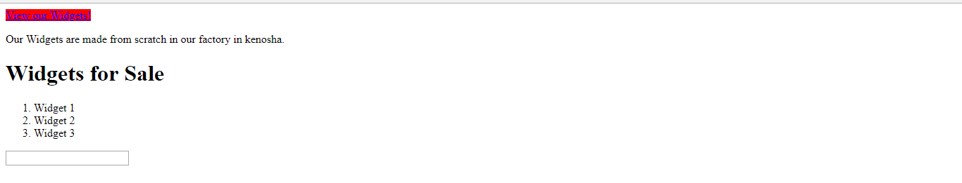
Inline elements
Do not start a new line
They take the minimum width necessary
Examples:
img, a, strong, input, textarea
Here <a> has a background-color of red to illustrate that.

Slide 52
When visualizing the space taken up by an element, we use
The Box-Model

Slide 53


Margin
Border
Padding
Content

Slide 54
Commenting Code
You always have the option to add comments to your code that will not be rendered in the browser
This is useful for documenting what you have done, or adding notes for things you need to do
It is also good to remind yourself what external files are doing or which sections closing tags belong to
<!-- comment -->

Slide 55
Simple best practices
Things to remember when writing HTML everyday

Slide 56
Best Practices
Use lowercase when writing HTML
Try to keep your html file small
Use _blank for external links only and always
_blank tells the browser to open a new window (or tab, if that's the user's preference) when that link is clicked.
Tackle accessibility, search engine optimization, and performance as you go
Remove comments from production code
Notes:
Reserved characters in HTML must be replaced with character entities

Slide 57
What we covered
Tags
Attributes
Links and page anchors
How to incorporate CSS
Forms and input
HTML 5 semantic layout elements
Block-level vs inline
The box model
Comments
Best practices
How to incorporate CSS
Adding JavaScript

Slide 58
CSS basics
Spiffing up all the things

Slide 59
What is CSS?

Slide 60
CSS is Cascading Style Sheets There are three types of CSS:
internal, external, inline

Slide 61
What happens when we want to start using CSS on our pages?

Slide 62
What happens when we want to start using CSS on our pages?
We can use:
<style> & <link>

Slide 63
For internal styles:
<head>
<style>
body {
color: red;
}
</style>
</head>

Slide 64
For external styles:
<head>
<link rel=“stylesheet” type=“text/css” href=“styles.css”>
</head>

Slide 65
For inline styles
<body>
<p style=“color: red;”>We sell quality widgets!</p>
</body>
Know that inline styling is an option, but it is not “best-practice”. Stick to using an external stylesheet.

Slide 66
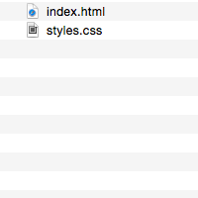
Let’s create an external style sheet
Create a new file in Sublime. Save it as styles.css in the same directory at index.html
(save it to the Desktop)

Slide 67
Add some styles
to your new css file
body {
background-color: yellow;
}

Slide 68
Link to your styles,
in index.html
<head>
<title>This is the title of your website</title>
<link rel=“stylesheet” type=“text/css” href=“styles.css”>
</head>

Slide 69
Add some styles
to your new css file
body {
background-color: yellow;
}
h1 {
color: blue;
}

Slide 70
External styles:
improve page performance
improve SEO
improve site-wide structure and control

Slide 71
Without using internal or inline styles,
How can we style 3/4 of our paragraphs?

Slide 72
IDs & CLASSes

Slide 73
Classes and ids are attributes that correspond to styles in your CSS.

Slide 74
Add some styles
to your css file
body {
background-color: yellow;
}
h1 {
color: blue;
}
.intro-text {
font-size: 20px;
letter-spacing: 5px;
}
#welcome-tagline {
color: blue;
font-style: italic;
}

Slide 75

Use the styles,
in your markup

Slide 76
IDs
IDs should only be used once on a page.
You can only use one ID on an element.

Slide 77
Classes may be used multiple times.
You may also ‘chain’ multiple classes on an element.
<p class=“details big-text”>Paragraph 1</p> <p class=“main-intro details big-text”>Paragraph 2</p> Here both paragraphs use two of the same classes and paragraph 2 has 3 classes that it references in the external css file
CLASSes
Notes:
Order of styles is cascading, which means lower on the stylesheet takes precedence

Slide 78
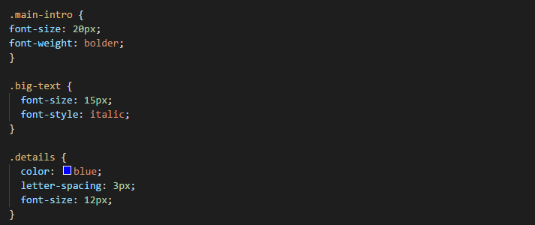
Effects of chaining classes
When using the classes big-text and details, details would overwrite the font-size because of cascading. Styles are applied, top to bottom.

Slide 79
Styles
CSS more specifically

Slide 80
Let’s go over some specific styles

Slide 81
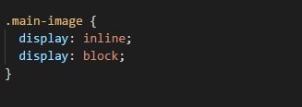
display
Common Values:
inline (default), block, none …
Notes:
Display property specifies the type of box used for an HTML element
Inline → Displays an element as an inline element (like <span>)
Block → Displays an element as a block element (like <p>)
None → The element will not be displayed at all (has no effect on layout)

Slide 82
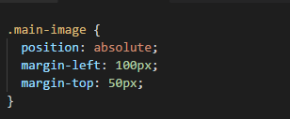
position
Common Values:
static (default), absolute, fixed, relative …
Notes:
position property specifies the type of
Static → Elements render in order, as they appear in the d
Absolute → The element is positioned relative to its first positioned (not static) ancestor elementocument flow positioning method used for an element
Fixed → The element is positioned relative to the browser window
Relative → The element is positioned relative to its normal position, so "left:20px" adds 20 pixels to the element's LEFT position

Slide 83
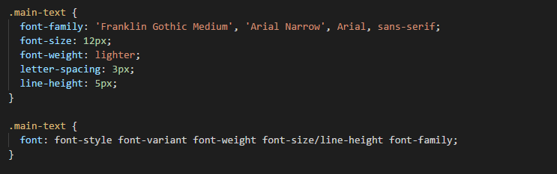
font
Shorthand version listed second

Slide 84

background

Slide 85
What we covered
Tags
Attributes
Links and page anchors
How to incorporate CSS
Forms and input
HTML 5 semantic layout elements
Block-level vs inline
The box model
Comments
Best practices
How to incorporate CSS
Adding JavaScript

Slide 86
HTML and JavaScript
The <script> tag is used to define client-side JavaScript
The <script> tag either contains scripting elements or points to an external file through the “src” attribute.
Common uses of JavaScript include form validation and dynamic changes of content.
Notes:
Order of styles is cascading, which means lower on the stylesheet takes precedence

Slide 87
HTML and JavaScript
There are 3 ways to incorporate JavaScript into HTML
1: In the <head> tag with a <script> tag that utilizes a “src” attribute
2: In the <body> of the <html> writing in-line scripts
3: In the <body> element just before the closing </body> tag as a <script> tag that utilizes a “src” attribute
Notes:
Order of styles is cascading, which means lower on the stylesheet takes precedence

Slide 88
This is the preferred way to implement JavaScript in your HTML.
HTML and JavaScript
<body>
<script src = “myScript.js”></script>
</body>
This will run the JavaScript from a file called myScirpt.js that is in the same directory of our index.html file.
Notes:
Order of styles is cascading, which means lower on the stylesheet takes precedence

Slide 89
Assignment
Build a 4 page website with links to each page.
Each page should have paragraphs and an image or two.
Build a stylesheet with at least 25 styles
Use tables, lists (ol & ul), heading tags, span tags, image tags etc..
Do some research on css :hover (hint: use this with your links)
Topic: Instructor’s choice!
Check out more info on selectors
http://www.w3schools.com/cssref/css_selectors.asp
Notes:
CSS selectors are patterns used to select the element(s) you want to style.
Parent element: https://www.w3schools.com/cssref/sel_element_gt.asp

